Slide 1

Color Sensing LED
Arduino with C Programming
ELECTRICAL ENGINEERING AND COMPUTER SCIENCE, COLLEGE OF ENGINEERING AND PHYSICAL SCIENCES
Notes:
Updated 20 June 2024 by Quinn Kwiatkowski

Slide 2
Goals
Use a TCS34725 Color Sensor to measure red, green, and blue (RGB) values of an object
Use the values from the TCS34725 Color Sensor to display the same color on an RGB Light Emitting Diode (LED)
Edit the code to display the complementary color of the detected object.

Slide 3
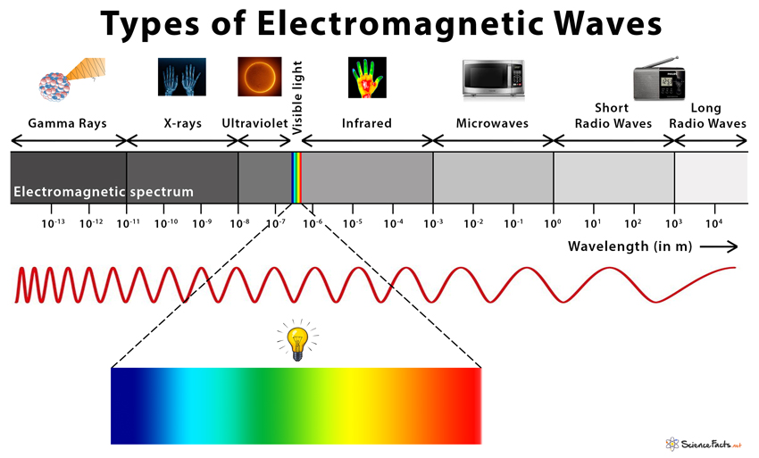
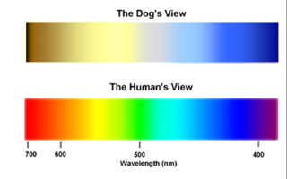
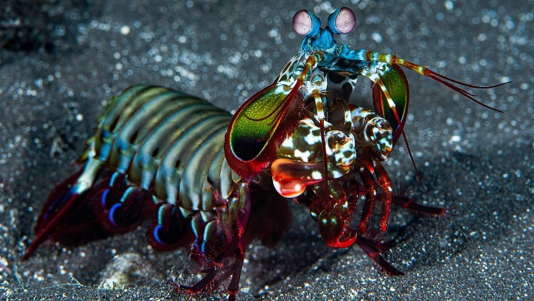



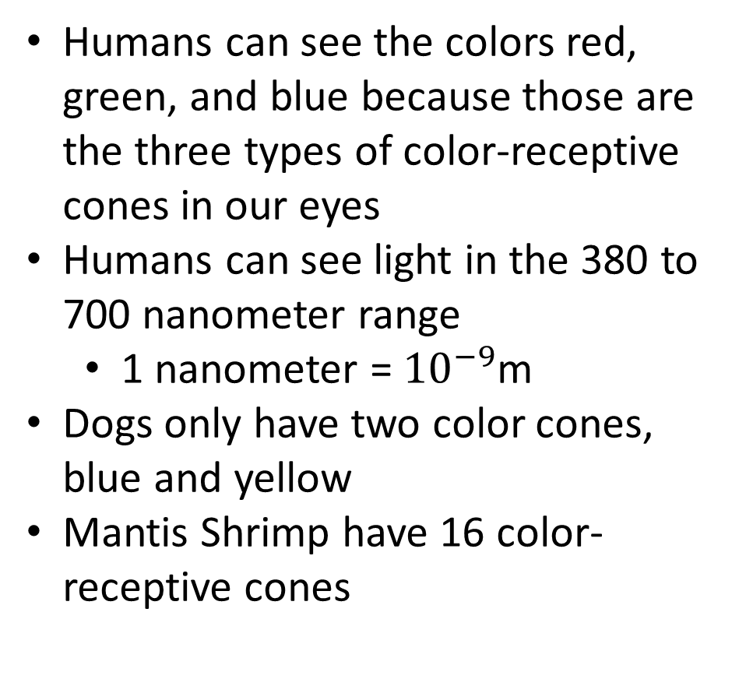
Introduction to Color
Humans can see the colors red, green, and blue because those are the three types of color-receptive cones in our eyes
Humans can see light in the 380 to 700 nanometer range
  1 nanometer = ${10}^{−9}$m
Dogs only have two color cones, blue and yellow
Mantis Shrimp have 16 color-receptive cones
Notes:
Color blindness happens when one or more of the color cone cells are absent, not working, or detect a different color then normal. Sever color blindness happens when all three cone cells are absent.
The human eye has about 6 million cones in it.

Slide 4
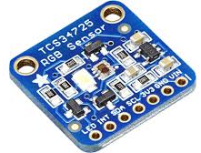
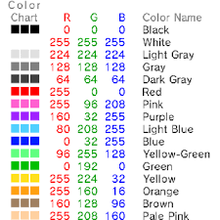

What is a Color Sensor?
An electronic sensor that emits light from a transmitter, and then detects the light reflected with a receiver
Color sensors can also measure color temperature and illuminance
Uses for color sensors
  Display of images in electronics
  Quality control for plastic colors using RGB or HEX color codes
  To make glasses that enhance color vision for specific color blindness
Notes:
Color blindness currently has not cure. Those colorblind glasses that you see advertised usually are for people with very specific color blindness, such as red-green color blindness. They are made with special minerals that help filter out some wavelengths between red and green. This reduce in color overlap allows for colors to look more vibrant and noticeable.
Working in a field like this might mean that you need to know what the color values are and how different minerals effect those lights and filter out specific RGB values.

Slide 5
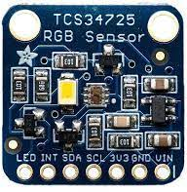
Components of the Color Sensor
White LED
White LED
  Emits light for the Sensor
TCS34725 Sensor
  Detects reflected light from the LED
LED Control Input
  Can toggle LED on and off for detecting colors
TCS34725 Sensor
I2C SDA
I2C SCL
Ground
3.3V Output
LED Control Input
Voltage In 3.3V
Interrupt Output

Slide 6
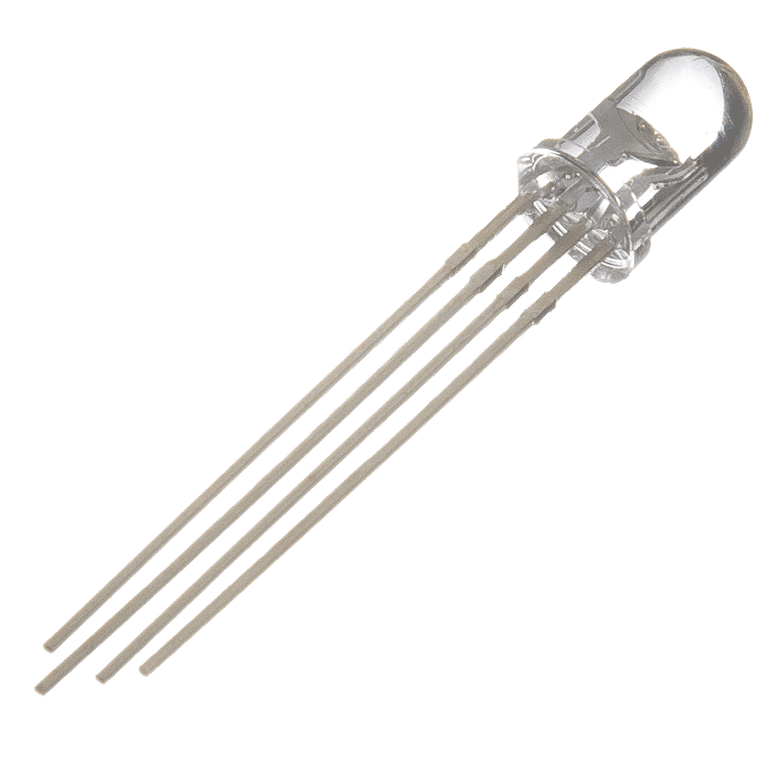
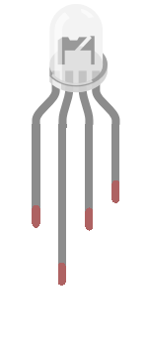
What is an RGB LED?
Red, Green, and Blue (RGB) Light Emitting Diode (LED) has the ability to produce any combination of red, green, and blue light
Common uses
  Decorations indoor/outdoor
  Stage lighting
  LED matrix displays
Blue
Red
Green
Ground

Slide 7
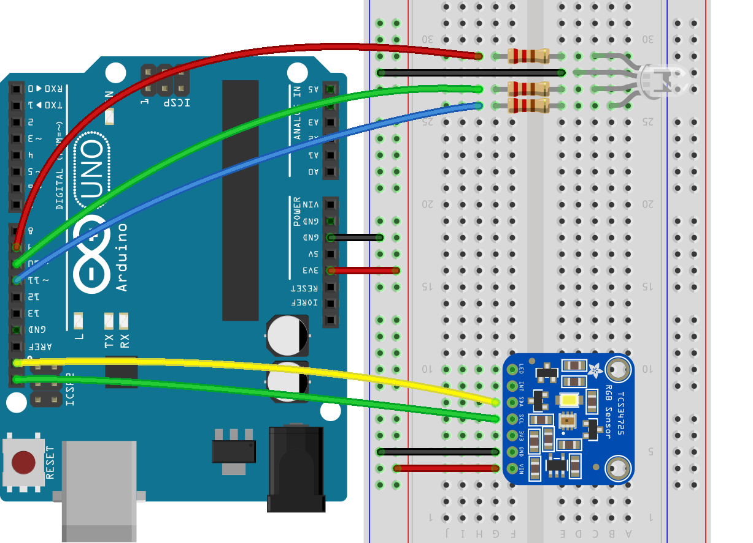
Circuit Diagram
Pin 9
220 Ω
GND
Pin 10
Blue
3.3V
Red
Pin 11
Green
SDA
SCL
Ground

Slide 8

Installing Necessary Libraries
2.) Search for the TCS34725
1.) Click Libraries

Slide 9
Installing Necessary Libraries
3.) Scroll down to find the Adafruit TCS34725
4.) Click INSTALL

Slide 10

Installing Necessary Libraries
5.) Click INSTALL ALL

Slide 11

Installing Necessary Libraries
6.) Make sure the library was successfully installed

Slide 12


Coding

Slide 13

Coding

Slide 14

Coding

Slide 15


Coding

Slide 16

Test it Out!
Run the program
  Click upload to send the code to the Arduino
  Click the serial monitor to see RGB values being displayed while the TCS34725 Color Sensor is on
Change lines 77-79 in the code to the following and see how that impacts what color is being displayed on the LED.
  Before running the code, click File>Save-as>Destination
  Name the file Color_Sensing_Complementary
  This allows you to have the original script and the modified version

